Slide 1
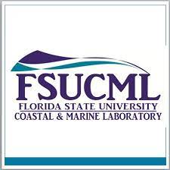


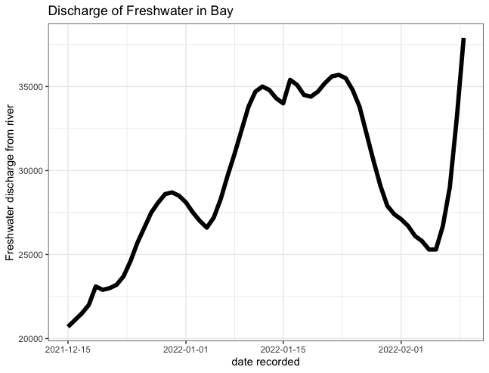
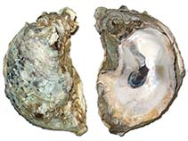
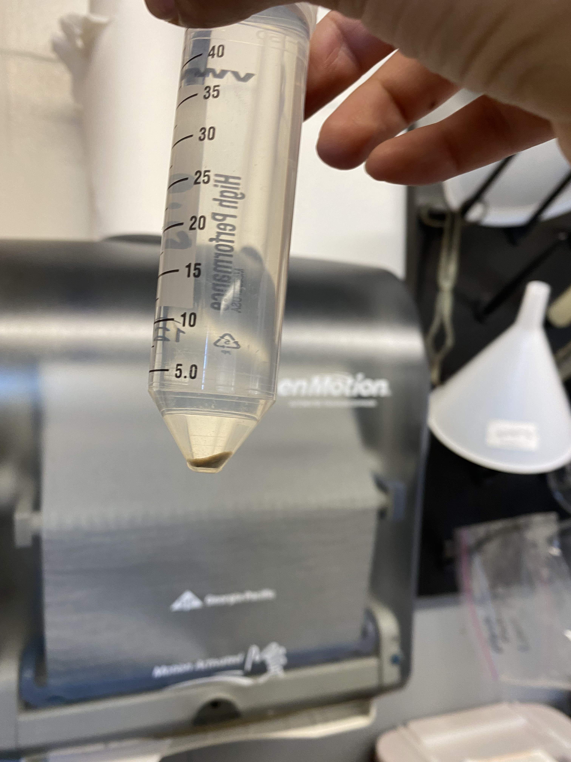
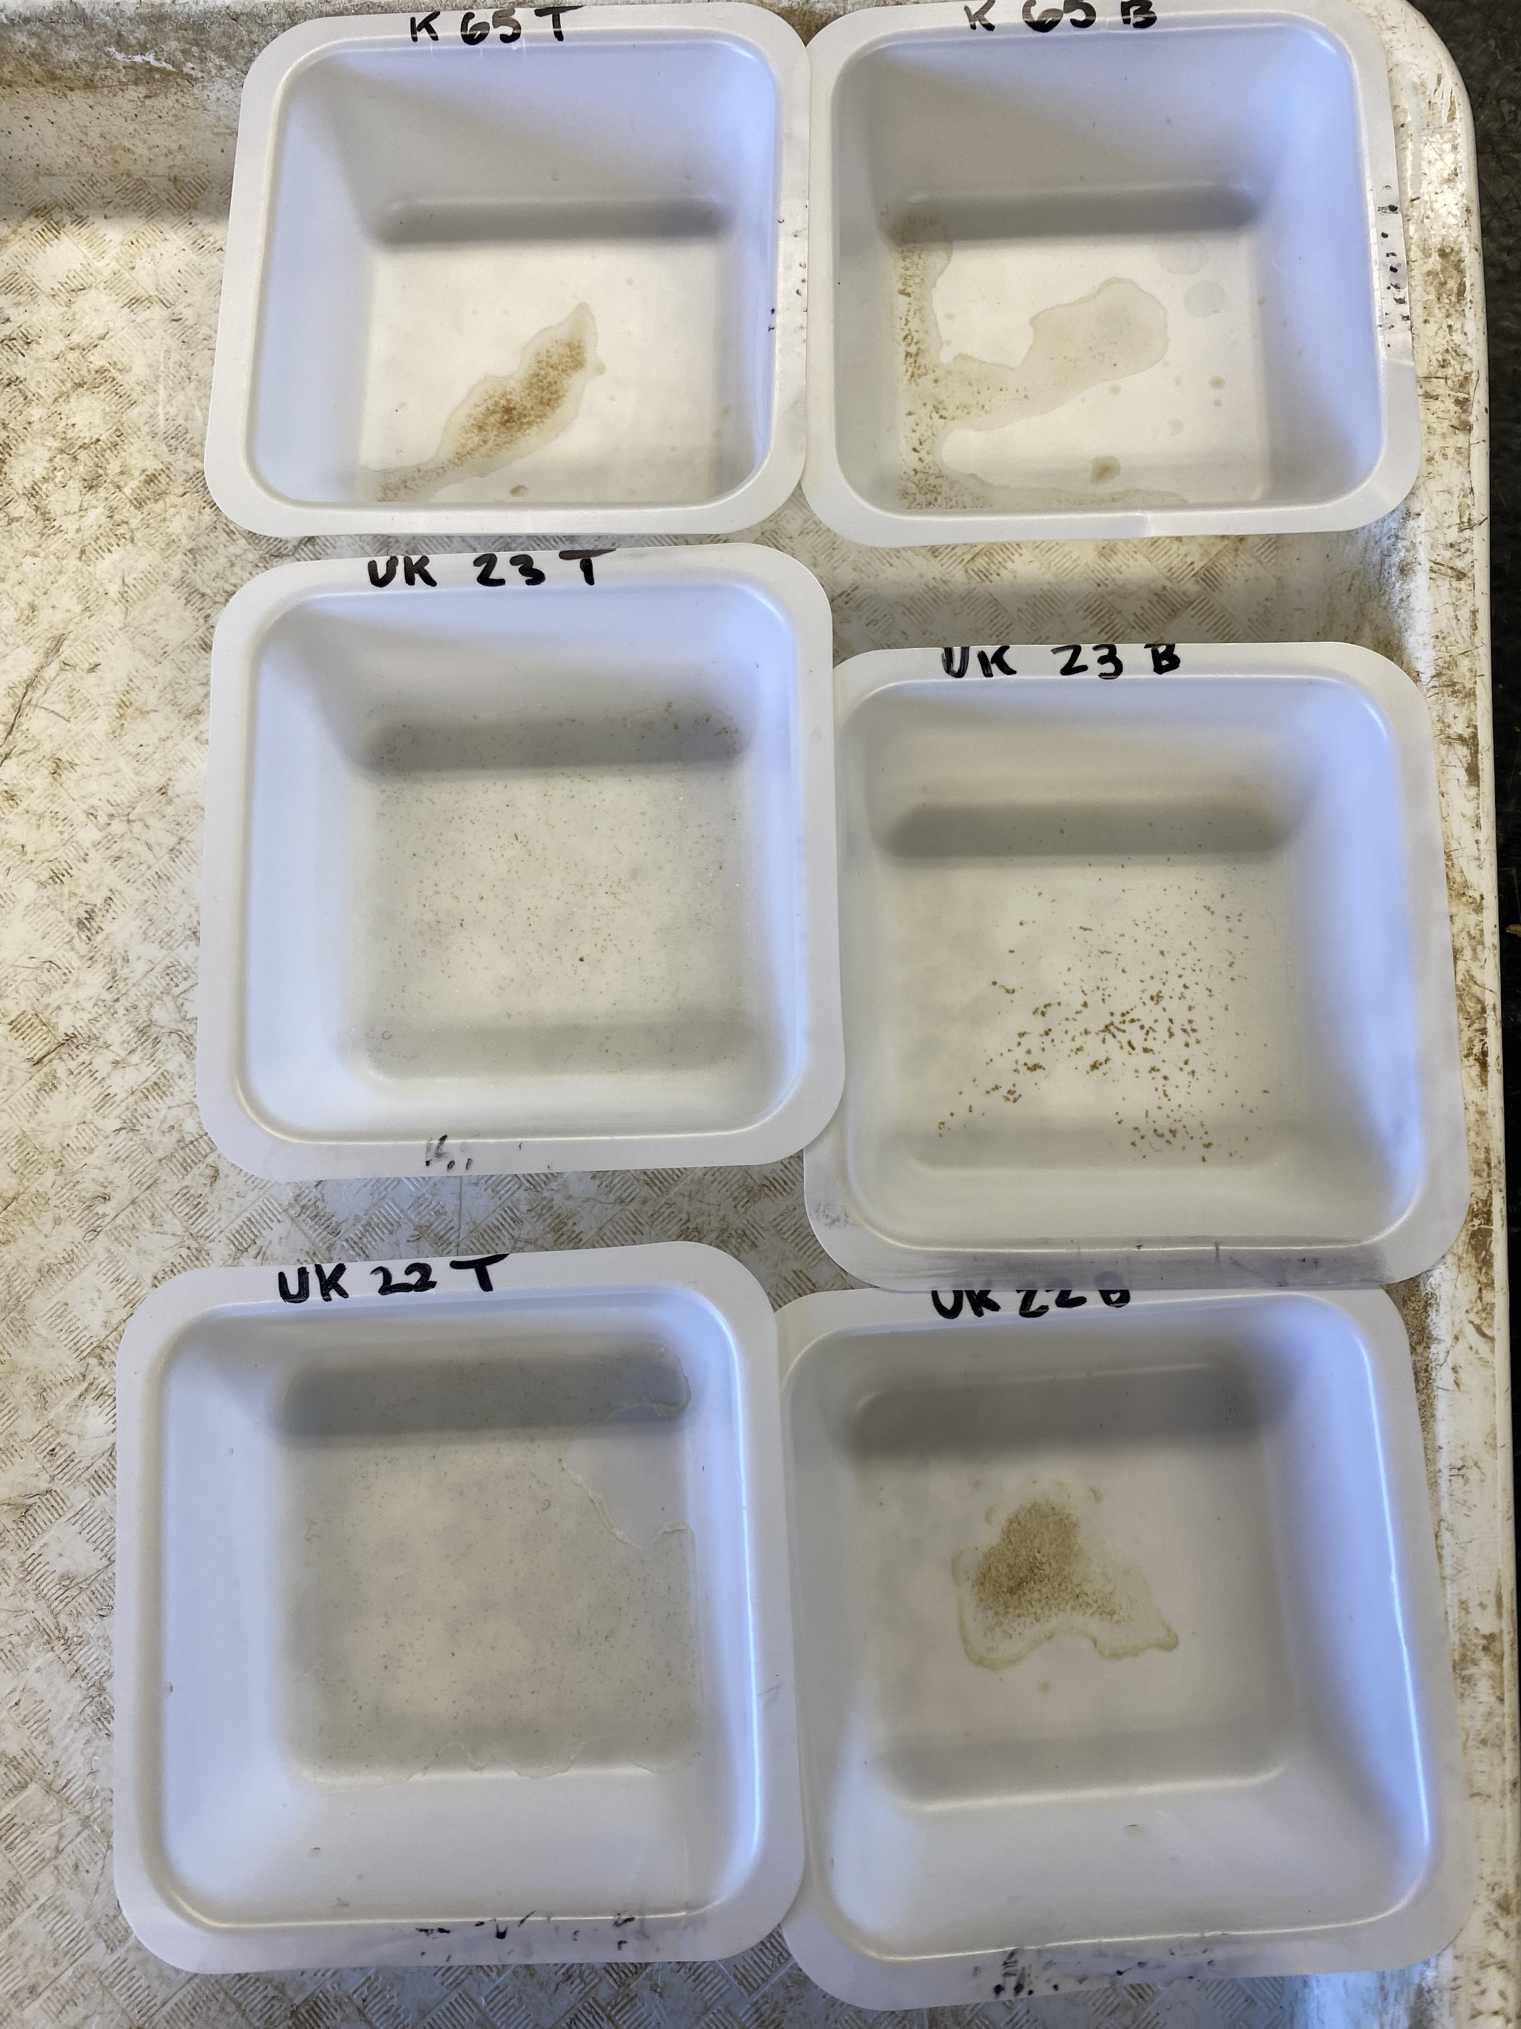
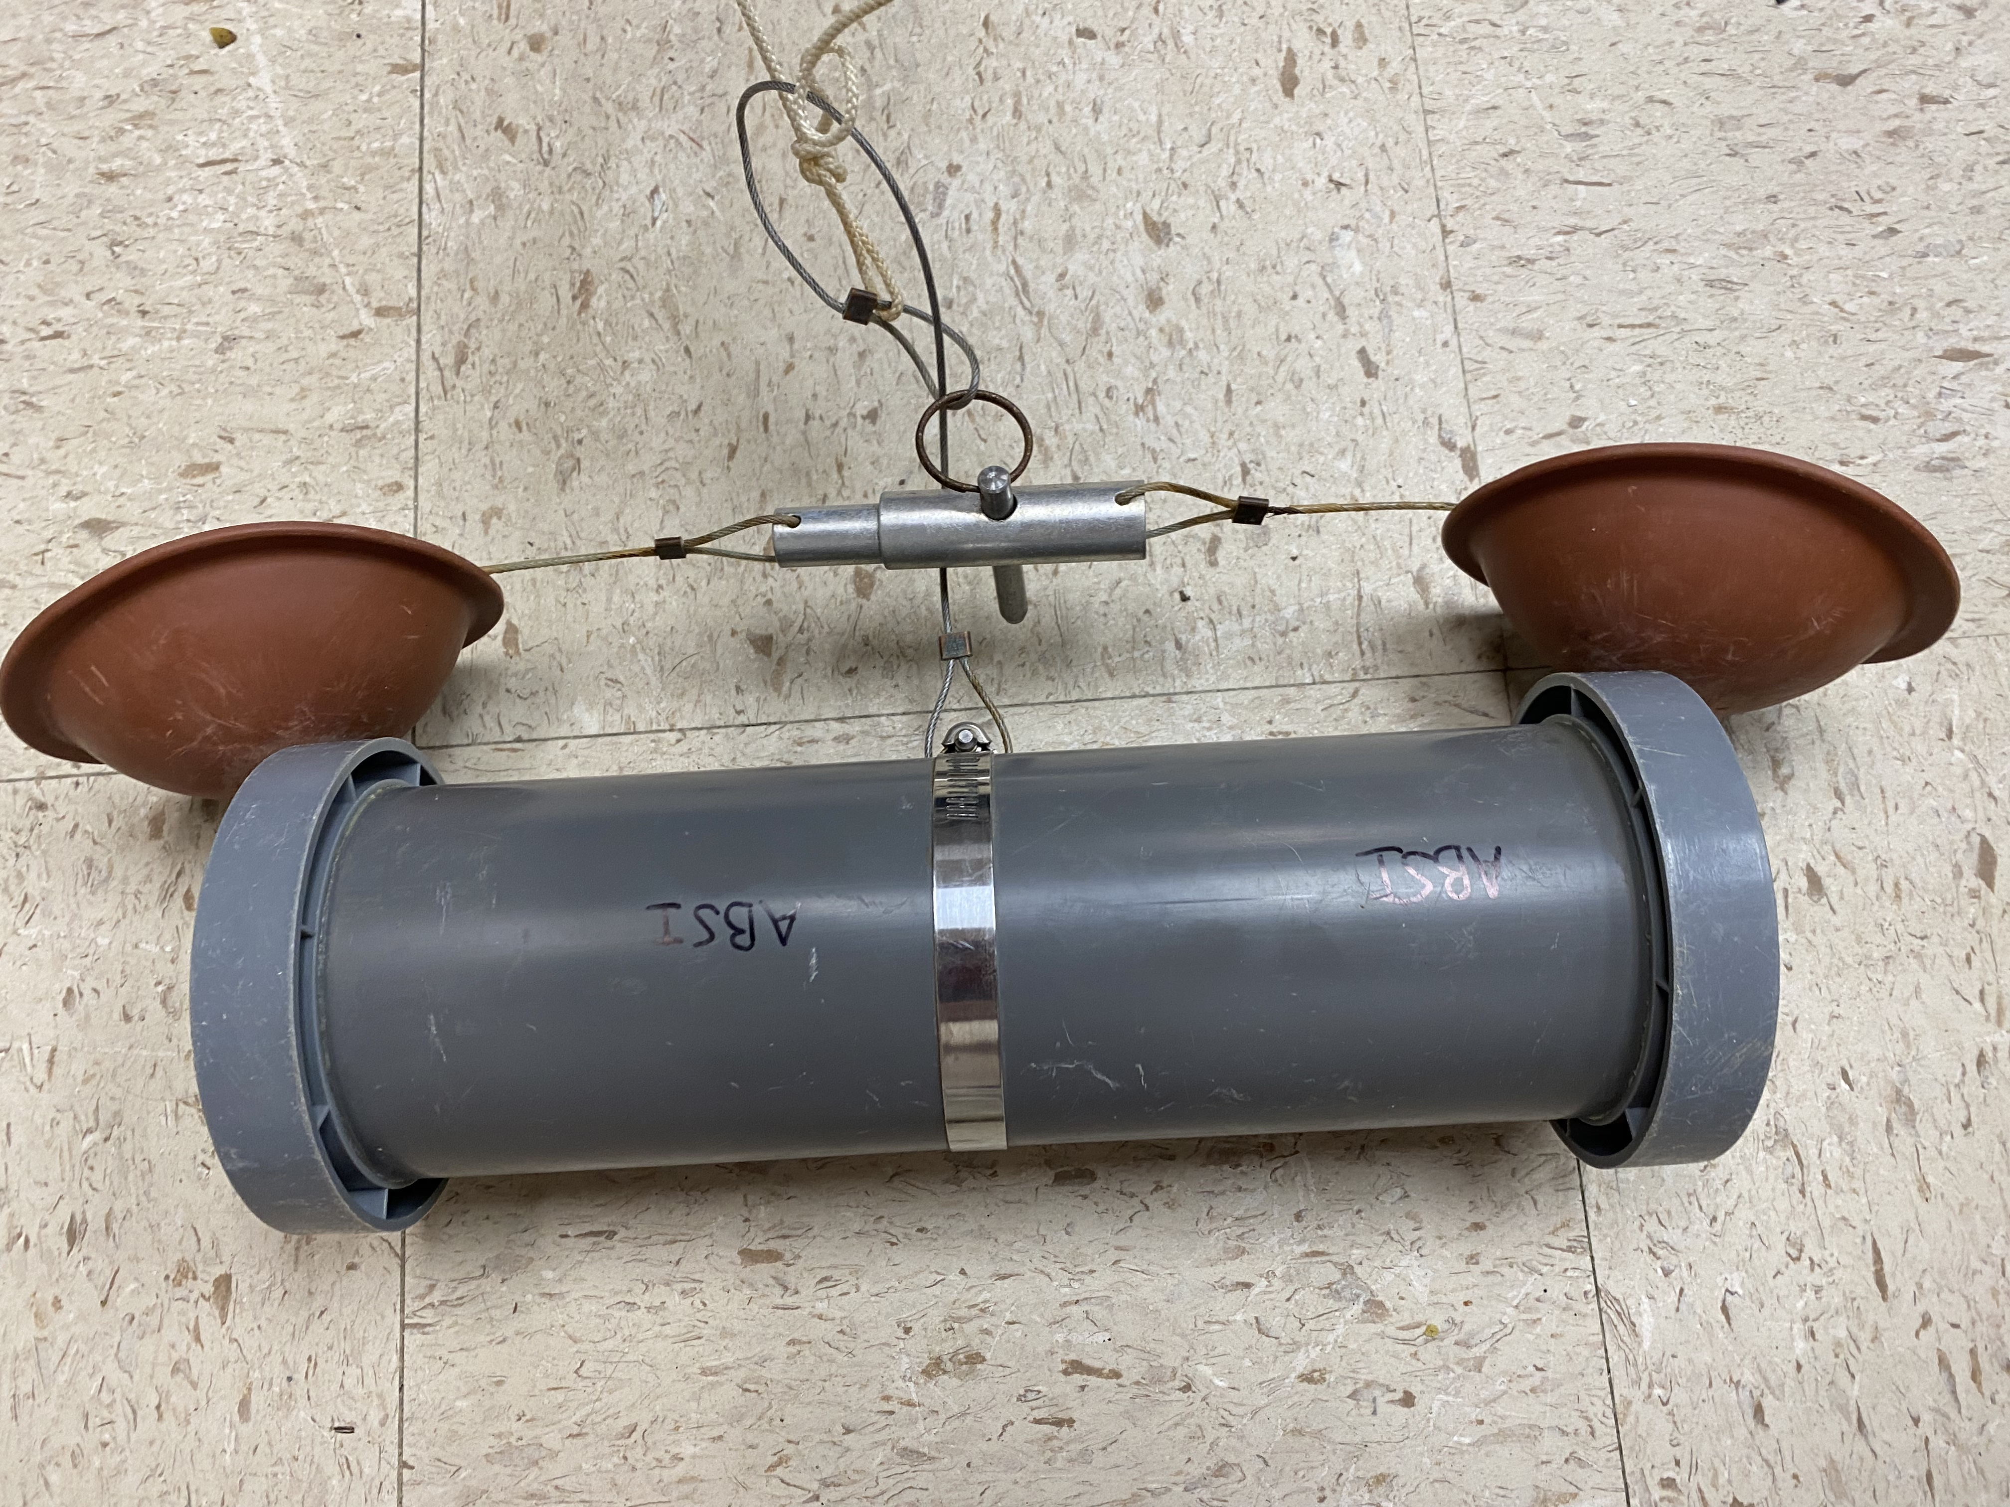
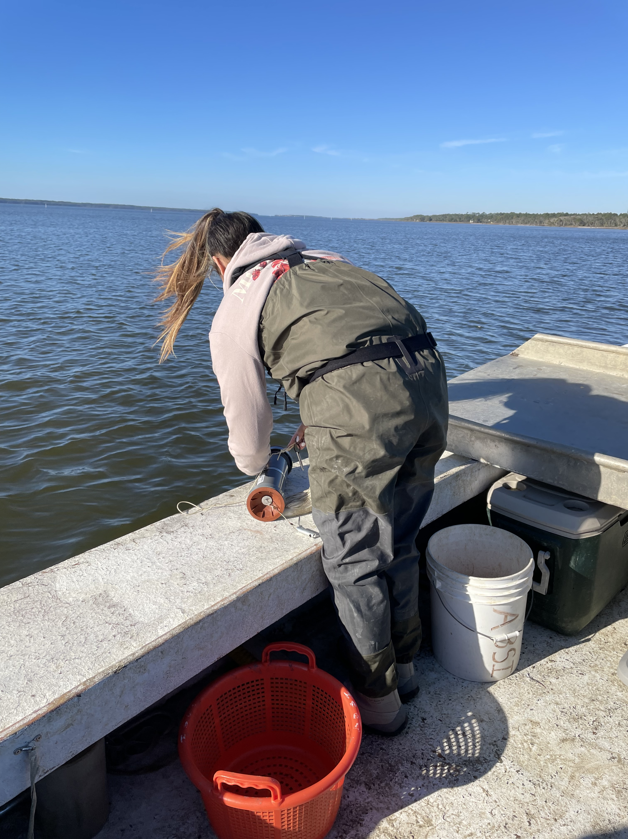
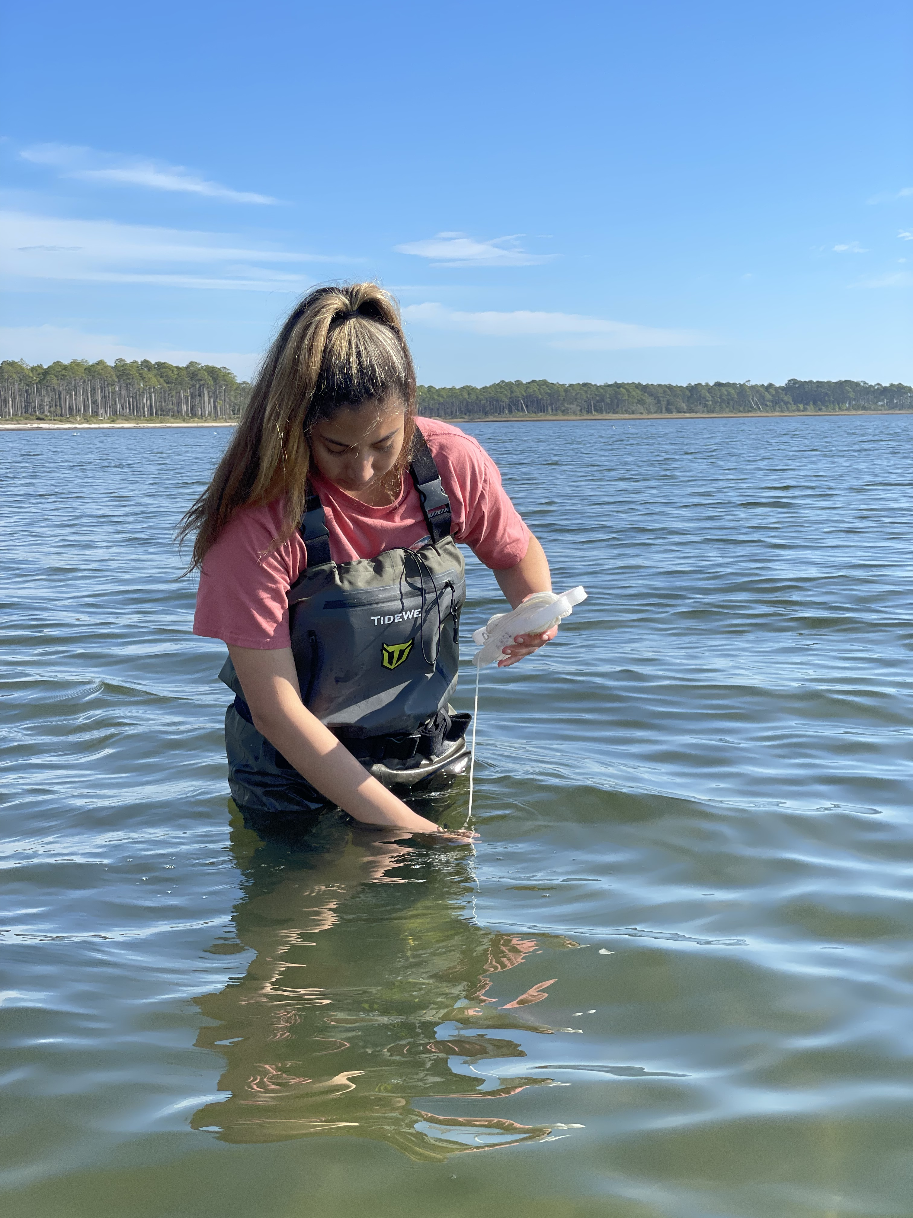
Measuring Suspended Solids at Eastern Oyster (Crassostrea virginica) Reefs in Apalachicola Bay
Ximena Rosasco and Barry Walton M.S.
Florida State University Coastal and Marine Laboratory
Introduction
The eastern oyster (hereafter oyster)
population in Apalachicola Bay is
threatened ¹
Several factors are contributing to
oyster decline ²
Spatiotemporal variations in
suspended sediment may be a factor
Sediment affects the nutrient availability, water clarity, and overall structure and function of estuarine habitats ³
Deposition of sediment due to waves, wind, and storms can kill oysters and bury their reefs ³
We quantified levels of suspended sediment present in our study area
Results
Eastern Oyster
photo credit: Jose Lietor
Fig. 2 Apalachicola River discharge (ft³/s) throughout study period
Methods
Opportunistically sampled water from 117 sites via Niskin bottle
100 mL subsamples were centrifuged to extract suspended sediment and weighed via microbalance (g)
Samples placed in drying oven for 72 hours to remove excess moisture
Salt content accounted for and removed to provide a final dry weight of only suspended sediment
Fig. 1: Surface and bottom suspended sediment (g/100ml). Sampling sites with oyster habitat in grey
Bottom samples had a larger amount of suspended sediment than surface samples (Fig. 1)
The discharge of freshwater into Apalachicola Bay increased during the months of sampling (Fig. 2)
Samples taken closer to the river had more suspended sediment
Quantity of sediment varied with the oyster habitats
Fig. 3 Centrifuged suspended sediment and final dry mass
Discussion / Conclusion
Results indicated that the quantity of suspended sediment varied spatially and with depth
Surface samples have less suspended sediment due to the sediment deposition on the oyster reefs
Suspended sediment loads were inversely related to river mouth proximity
Future research would use sediment traps to better incorporate temporal variation in abiotic factors
Acknowledgements
I would like to thank Alek Valles and FSUCML staff for mentoring me and giving me the opportunity to work alongside them.
References
[1] Camp, E. et al. (2015) Collapse of a historic oyster fishery: diagnosing cases and identifying paths
toward increased resilience. Ecology and Society. 20 (3). http://dx.doi.org/10.5751/ES-07821-200345
[2] Pine, W. et al. (2015) The curious case of eastern oyster Crassostrea virginica stock status in
Apalachicola Bay, Florida. Ecology and Society 20(3). https//doi.org/10.5751/ES-07827-200346
[3] Colden, A. et al. (2015) Lethal and sublethal effects of sediment burial on the eastern oyster Crassostrea
virginica. Marine Ecology Progress Series, 527, 105-117. https://doi.org/10.3354/meps11244
[4] USGS(2022) Discharge of Apalachicola River. Retrieved on February 10,2022, from https://waterdata.usgs.gov/monitoring-location/02359170/#parameterCode=00060&period=P7D
Niskin Bottle Sampler
Collecting water samples
Notes:
- C.virginica are a crucial component in structuring estuarine landscape
Sediment affects the function of the estuarine habitats such as nutrient availability, water clarity, and structure.

